Slide 1

Go, change the world
RV College of
Engineering
Phase-2
1RV20MC036
LAXMIKANTH
Under the Guidance
of
Dr.B.H. Chandrashekar
Associate Professor
RV Collage Of Engineering ,Bengaluru
Air Quality index Using machine Learning
14/05/2022 Department of MCA, RVCE

Slide 2

Go, change the world
RV College of
Engineering
Agenda
Introduction
Objectives of the Project Work
Changes suggested in Phase I and Incorporation
Tools and Technologies Used
Hardware and Software Requirements
Software Requirement Specifications
References

Slide 3
Go, change the world
RV College of
Engineering
Introduction and Objectives
Objectives of Project Work
The air quality index (AQI) is an index for reporting air quality on a daily basis
Comparing air quality conditions at different locations/cities.
It also helps in identifying faulty standards and inadequate monitoring programmers.
AQI helps in analyzing the change in air quality (improvement or degradation).

Slide 4
Go, change the world
RV College of
Engineering
Incorporation of Changes
List the changes suggested in Phase I and explain the changes incorporated
Inserted the details of date of publication and literature Survey paper title.
Added the explanation of proposed methodology.
Added Most related references with respect to the project.

Slide 5
Go, change the world
RV College of
Engineering
Project based Learning
List the new technologies / tools / courses learnt apart from the syllabus
Learnt basics of python libraries like NumPy, pandas.
NumPy :A library consisting of multidimensional array objects and a collection of routines for processing those arrays
Pandas : Pandas is an open source Python package that is most widely used for data science
Matplotlib : Matplotlib is a low level graph plotting library in python that serves as a visualization utility.

Slide 6
Go, change the world
RV College of
Engineering
Design Methodology
Technologies Used tools :
Anaconda Navigator(2.1.1)
Jupiter notebook (V6.4.11)
Algorithms :
Decision tree
Random Forest Model
Logistic regression

Slide 7
Go, change the world
RV College of
Engineering
Design Methodology
Details of the Hardware and software Requirements
Hardware Requirements:
Operating System : Windows
RAM : 4 GB or more
Storage : 8GB or more
Input Devices : Keyboard, Mouse
Software Requirements :
Operating System - Linux- Ubuntu 16.04 or later - Windows 7 or newer - Mac OS X v10.7 or higher
Browser: Firefox, Google Chrome or Apple Safari
Programing language : Python(3.9.3)
Html ,CSS, Bootstrap

Slide 8
Go, change the world
RV College of
Engineering
Software Requirement Specification
Module Description : All the modules should be explained as below
Module Name :Data Pre-Processing
Purpose :Reading each frame from the inputs given.
Input :To make the process easier, data pre-processing
Function:Cleaning the data and making it suitable for a machine learning model
Output : Preparing the raw data and making it suitable for a machine learning model
Module Name :Data Analysis
Purpose : Data analysis that automates analytical model building.
Input : Docuses on creating and training algorithms through data
Function: Data analysis that automates analytical model building.
Output : It will remove duplicate data

Slide 9
Go, change the world
RV College of
Engineering
Software Requirement Specification
Functional Requirements
Requirement analysis is a software engineering task that bridges the gap between system level software allocation & software design.
It enables the system engineer to specify software interface with other system elements & establishes design constraints that the software must meet.
It provides the software design with a representations of information & function that can be translated to date, architecture & procedural design.

Slide 10
Go, change the world
RV College of
Engineering
Software Requirement Specification
Non Functional Requirements
Reliability:
It is very user friendly, software is secure and there is not much maintenance. Project can be upgraded as per the requirement step by step.
Compatibility:
Describes requirements such as those connected with individual customization or operations in specific competing environments.
Security :
Project level security is set. User needs tologin when they start the program option is also provided to create the additional user and level security

Slide 11
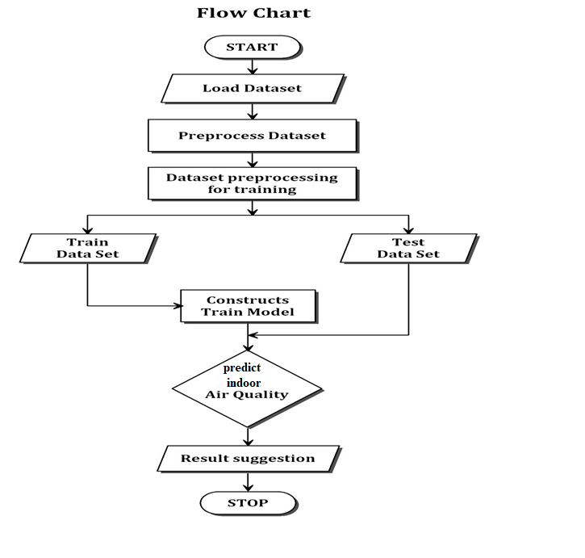
Go, change the world
RV College of
Engineering
Higher Level Design
Block diagram

Slide 12
Go, change the world
RV College of
Engineering
Higher Level Design
A flowchart is one of the seven basic quality tools used in project management and it displays the actions that are necessary to meet the goals of a particular task in the most practical sequence
this particular tool is very used in estimating and understanding the cost of quality for a particular process.
This is done by using the branching logic of the workflow.
There are available to help project managers manage their tasks and schedule and one of them is the flowchart.

Slide 13
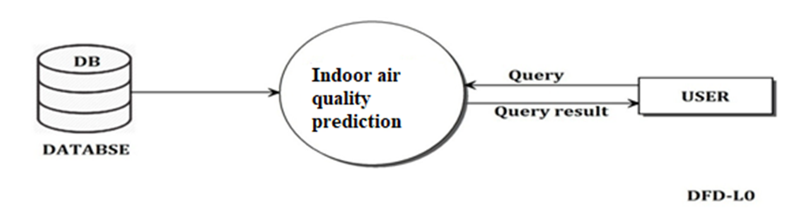
Go, change the world
RV College of
Engineering
Higher Level Design
Level 0 Diagram
A data flow diagram (DFD) is graphic representation of the "flow" of data through an information system. A data flow diagram can also be used for the visualization of data processing (structured design).
It is common practice for a designer to draw a context level DFD first which shows the interaction between the system and outside entities. DFD’s show the flow of data from external entities into the system, how the data moves from one process to another, as well as its logical storage.

Slide 14
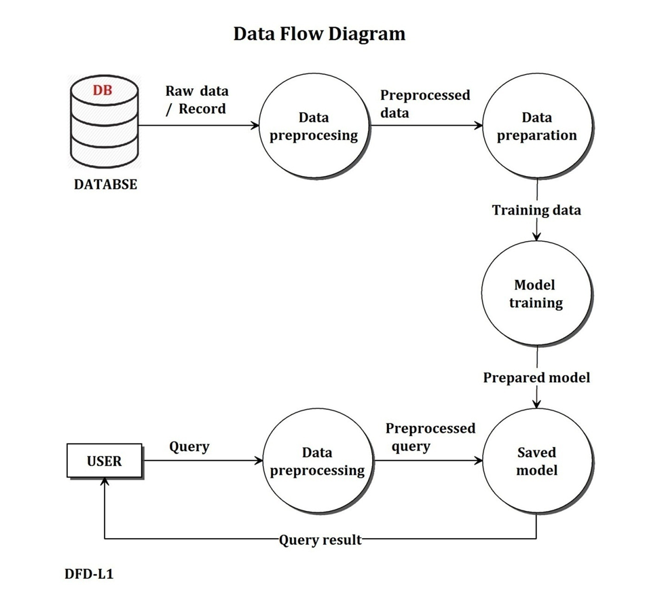
Go, change the world
RV College of
Engineering
Higher Level Design
Level 1 Diagram

Slide 15
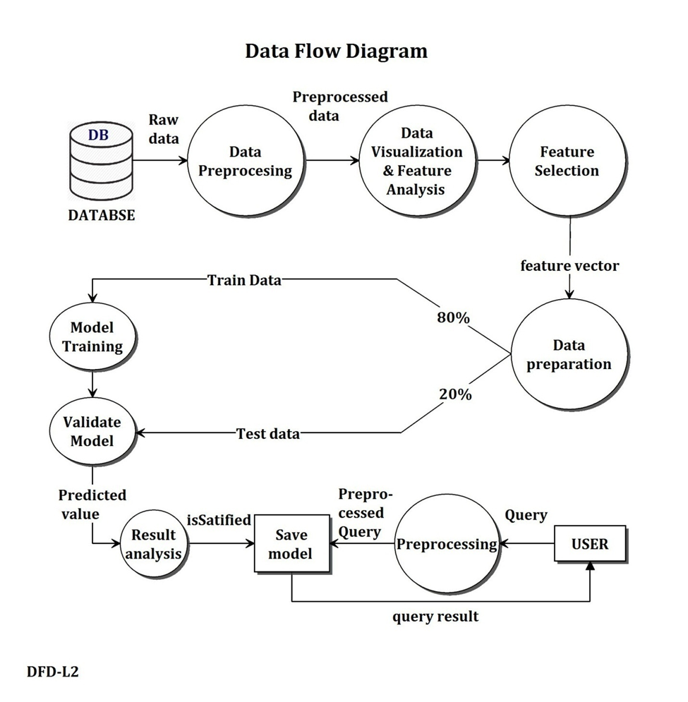
Go, change the world
RV College of
Engineering
Higher Level Design
Level 2 Diagram

Slide 16
Go, change the world
RV College of
Engineering
Future work
Percentage of Project completed
40% of work is done 60 % is remaining.
Plan for further work
Next is Implementation in that implementation in this project taken a database
The air pollution databases were extracted from the Central Pollution Control Board (CPCB)
Predicting the air quality is a complex task due to the dynamic nature, volatility, and high variability in space and time

Slide 18
Go, change the world
RV College of
Engineering
References
References
[1]Mrs. A. GnanaSoundariMtech, (Phd) ,Mrs. J. GnanaJeslin M.E, (Phd), Akshaya A.C. “Indian Air Quality Prediction And Analysis Using Machine Learning”. International Journal of AppliedEngineering Research ISSN 0973-4562 Volume 14, Number 11, 2019 (Special Issue)
[2] Suhasini V. Kottur , Dr.S. S. Mantha. “An Integrated Model Using Artificial Neural Network (Ann) And Kriging For Forecasting Air Pollutants Using Meteorological Data”. International Journal of Advanced Research in Computer and Communication Engineering ISSN (Online) : 2278-1021 ISSN (Print) 2319-5940 Vol. 4, Issue 1, January 2015
[3] RuchiRaturi, Dr. J.R. Prasad .“Recognition Of Future Air Quality Index Using Artificial Neural Network”.International Research Journal of Engineering and Technology (IRJET) .e-ISSN: 2395-0056 p-ISSN: 2395-0072 Volume: 05 Issue: 03 Mar-2018

Slide 19
Go, change the world
RV College of
Engineering
References
References
[4] Aditya C R, Chandana R Deshmukh, Nayana D K, Praveen Gandhi Vidyavastu .” Detection and Prediction of Air Pollution using Machine Learning Models”. International Journal of Engineering Trends and Technology (IJETT) – volume 59 Issue 4 – May 2018
[5] Gaganjot Kaur Kang, Jerry ZeyuGao, Sen Chiao, Shengqiang Lu, and Gang Xie.” Air Quality Prediction: Big Data and Machine Learning Approaches”. International Journal of Environmental Science and Development, Vol. 9, No. 1, January 2018

